Slide 1
Introducing ROBOTICS ARM
Notes:
This presentation demonstrates the new capabilities of PowerPoint and it is best viewed in Slide Show. These slides are designed to give you great ideas for the presentations you’ll create in PowerPoint 2010!
For more sample templates, click the File tab, and then on the New tab, click Sample Templates.

Slide 2
Outline:
1-Introduction
2-Mechanical hardware
3-Electronic hardware
4-Software

Slide 3


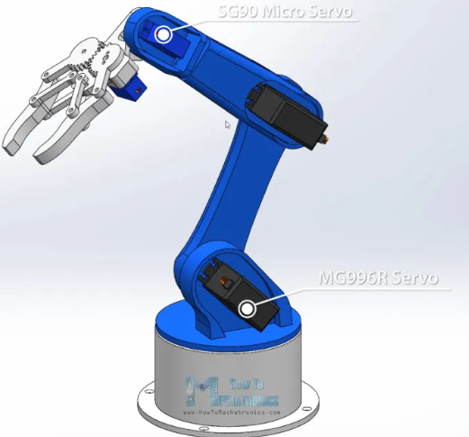
ROBOTICS ARM
What is a

Slide 4
AIM OF THE PROJECT
Design a Six Degree Of Freedom robot arm to do many of the tasks requiring high precision, speed and endurance.
Use Artificial intelligence and machine to recognize patterns in a video feed and perform dynamic actions based upon the circumstances.
Build a physical working model of a robotic arm.

Slide 5
ROBOTIC ARM
A robotic arm is a robotic manipulator, usually programmable, with similar functions to a human arm.
Robot manipulators are created from a sequence of link and joint combinations.
Joints allowing either rotational or translational motion.
Can be modified to perform various other tasks .

Slide 6
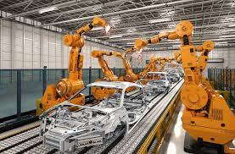
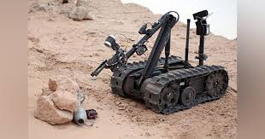
Current industry uses
Robotic arms are used in many manufafcturing units to perform tasks with perfection
The Army also use such arms for bomb diffusion or unknown object detection in sensetive areas

Slide 7
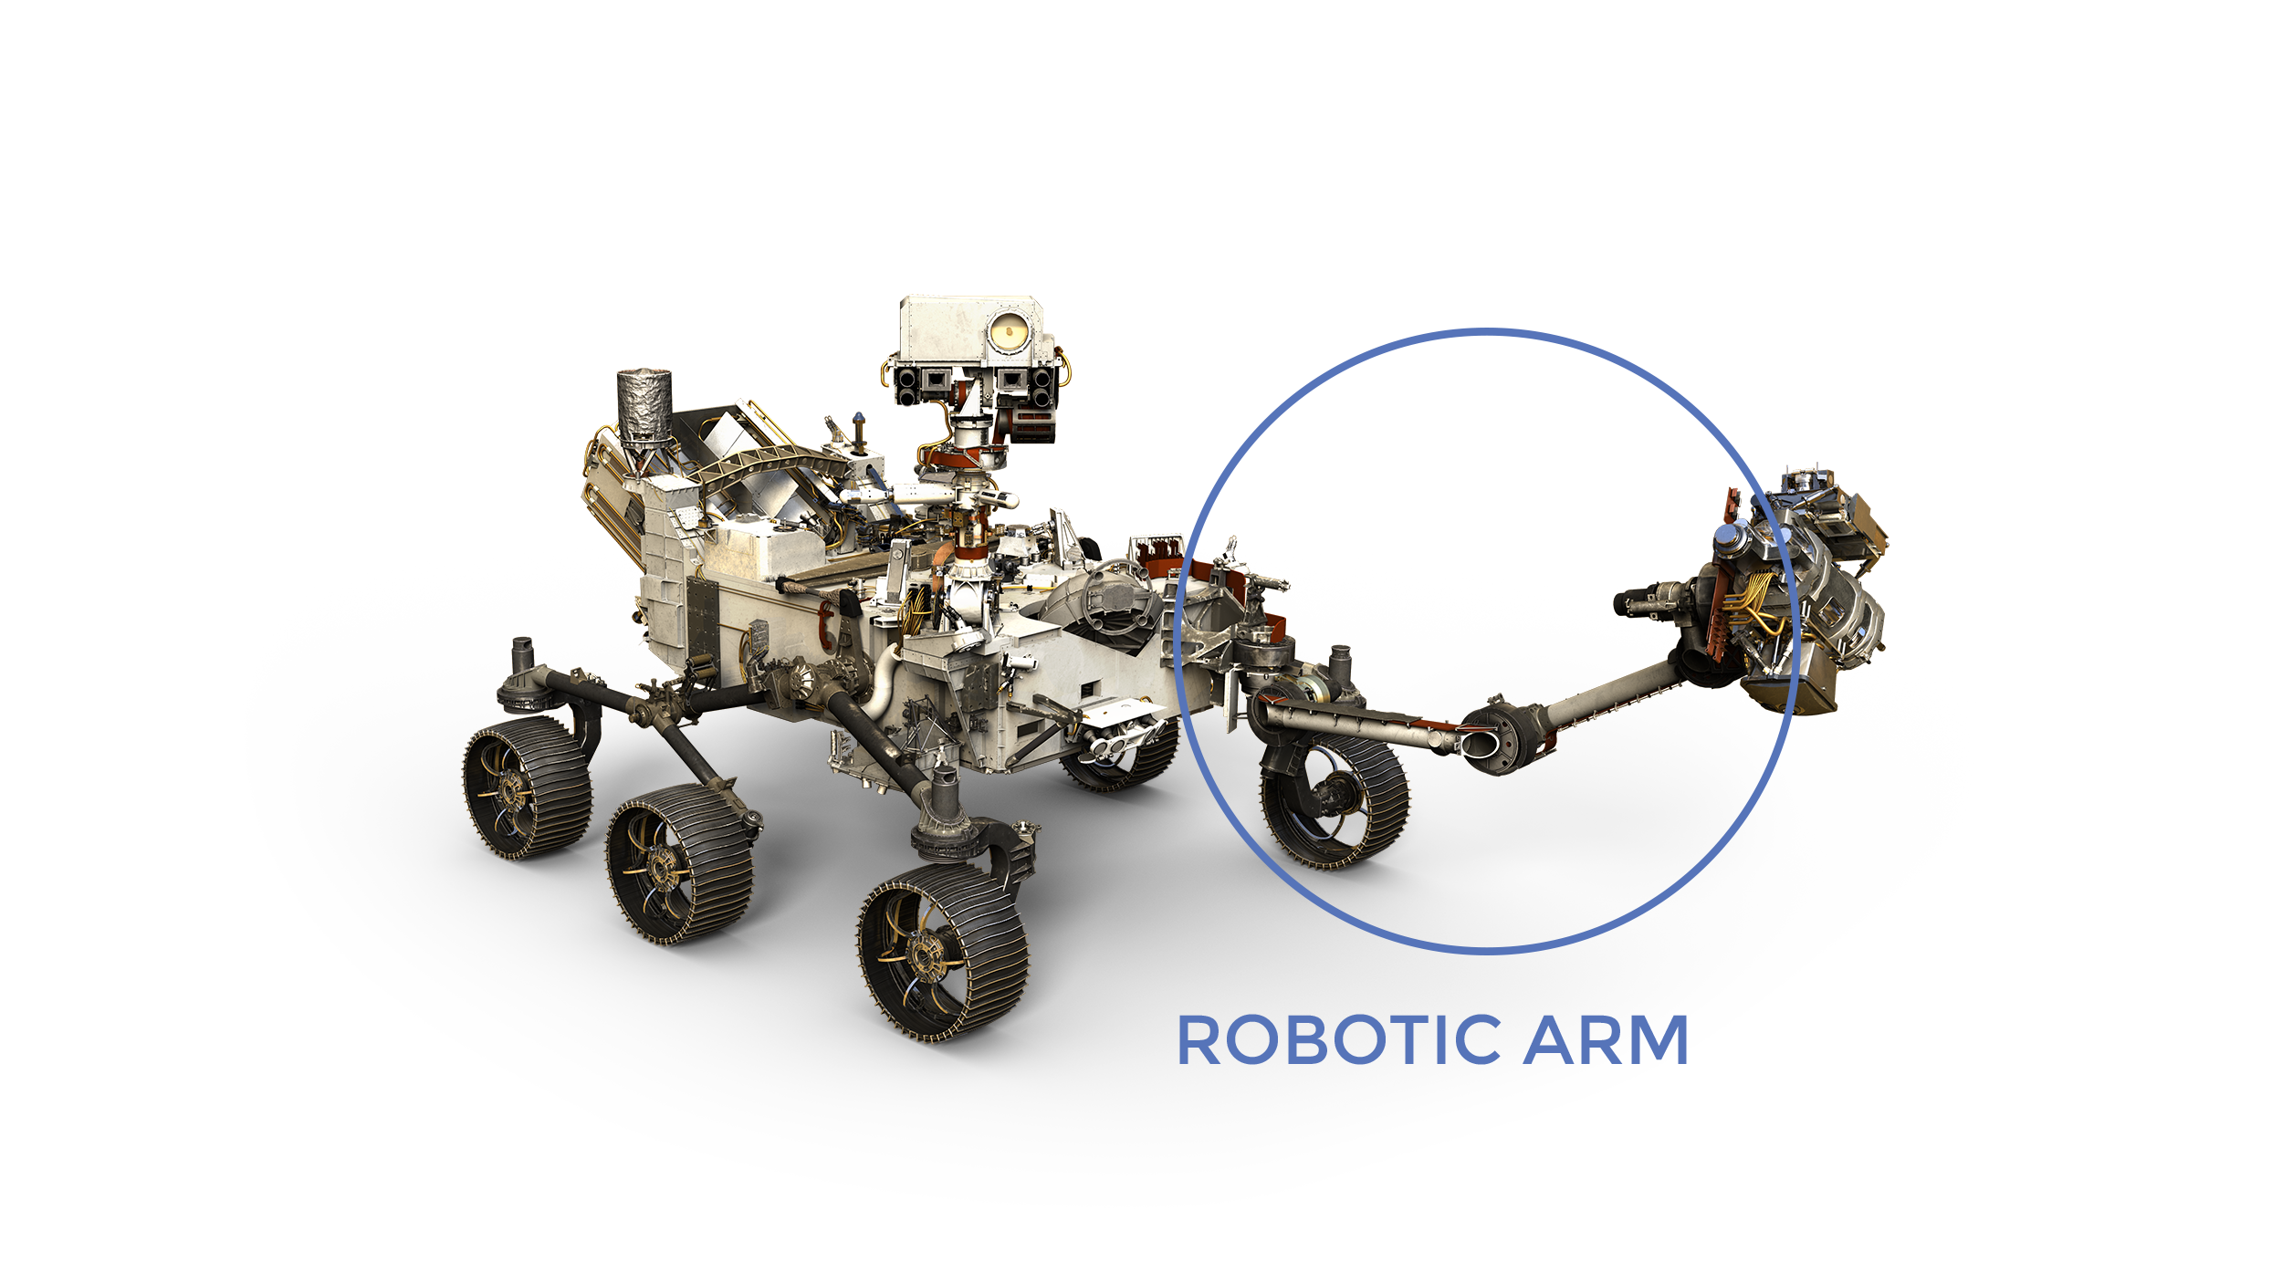
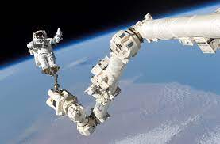
Robotic arms in Space
During the last Mars exploration mission by NASA . A Robotic arm was attached to the rover for collecting samples and drilling holes
International space sation has a similar arm for making Space Walk easier.

Slide 8
3 Phases of the Project
1
2
3
Mechanical hardware
Electrical hardware
Software
We have technical details for every step of the way

Slide 9

Mechanical hardware
1
1

Slide 10
Robotic Arm Design Mechanical Hardware
Robot arm design
3D Printing
Assembly
Base
Mount
Electric
Assembly
Servo Motors

Slide 11
Robot arm design
In our design we tried to reduce the cost and we have built it from tools can be found for free.
In the beginning we designed our robotic arm using SolidWorks
We tend to use light weight material to make the frame efficient , smaller motors are capable of operating these parts

Slide 12
Components
The Arm is divided into 10 singular 3D printed parts which will be assembled to make different components of the arm.
Servo , the movement component of the arm.
Arduino, the heart and the brain of this project

Slide 13
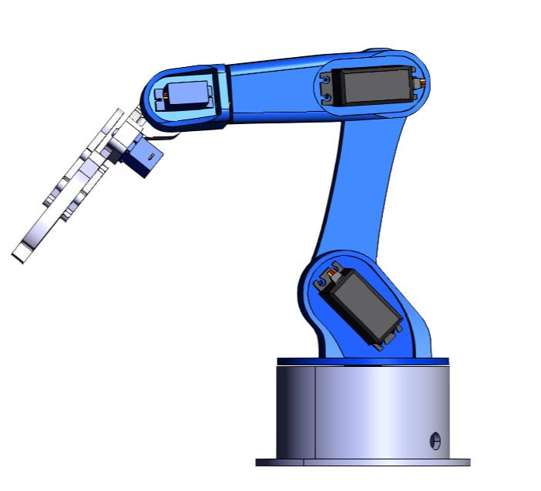
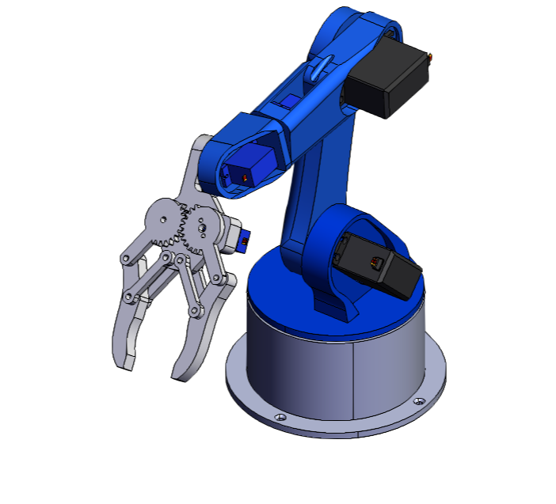
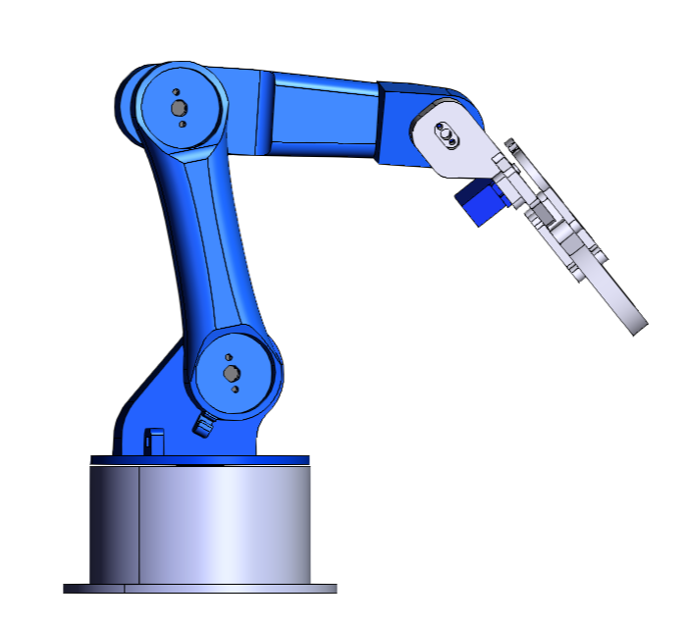
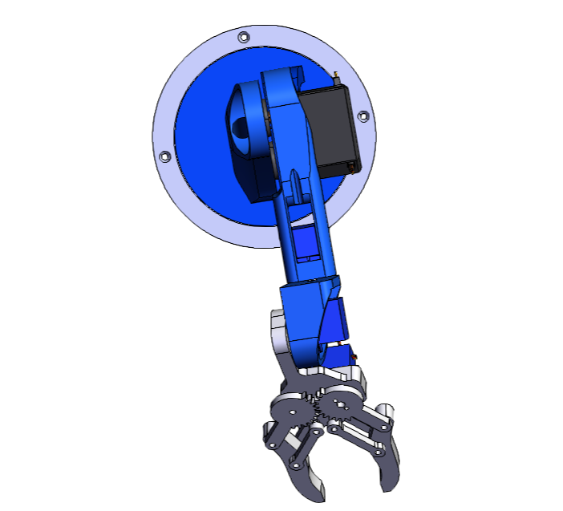
3D Renders of our Design

Slide 14
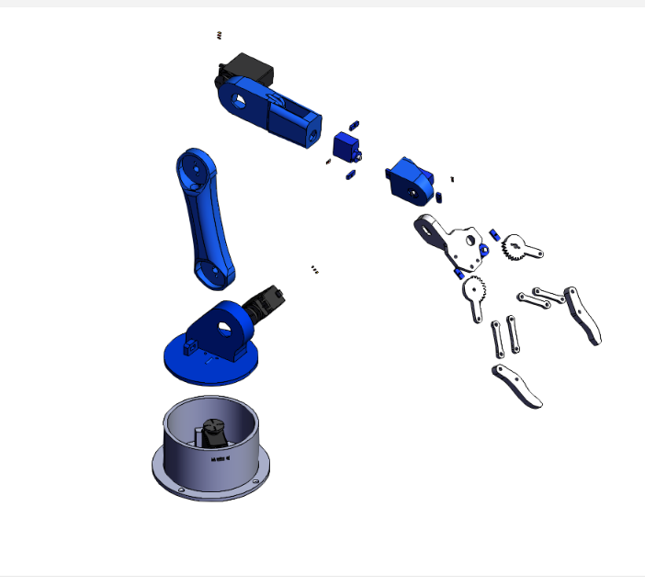
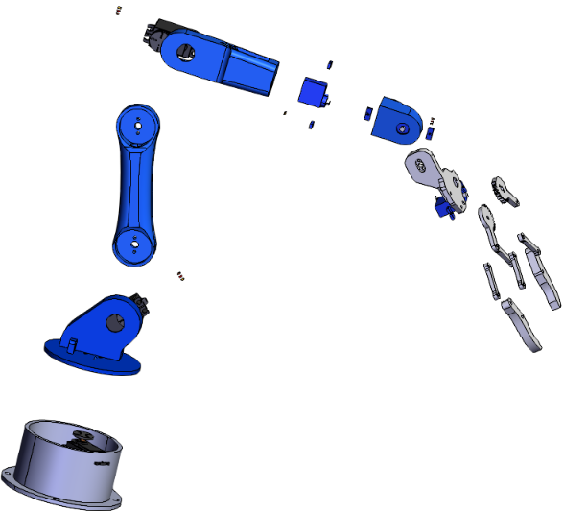
Disassembled view
A total of 15 3D printed comopnents will be joined togather to make this project

Slide 15
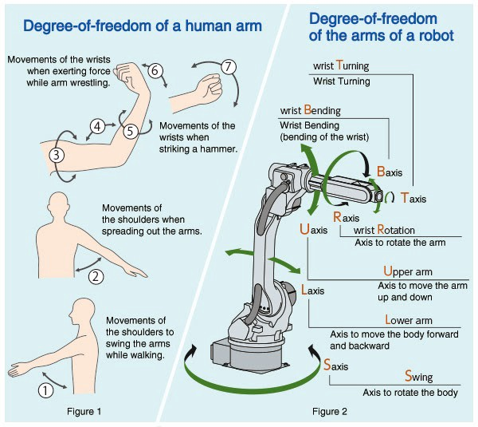
6 Axis Movement

Slide 16
Why 3D Printing ?
Light weight and strong
Rapid Prototyping
Easy to make complex Structures
Cost efficient
Parts can be easily repaired / replaced

Slide 17

Electrical hardware
2

Slide 18
Robotic Arm Design Electrical Hardware
Python
Image
Processing
Serial
Com
Data link
Process Execution
Arduino Uno
AI operations

Slide 19
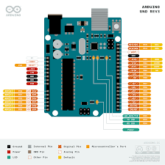
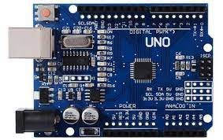
Arduino UNO
1.The Core , the heart of this project is Arduino Uno . This is used to control the hardware from the software .
2. It uses ATmega128 microcontroller to control the operaations.

Slide 20
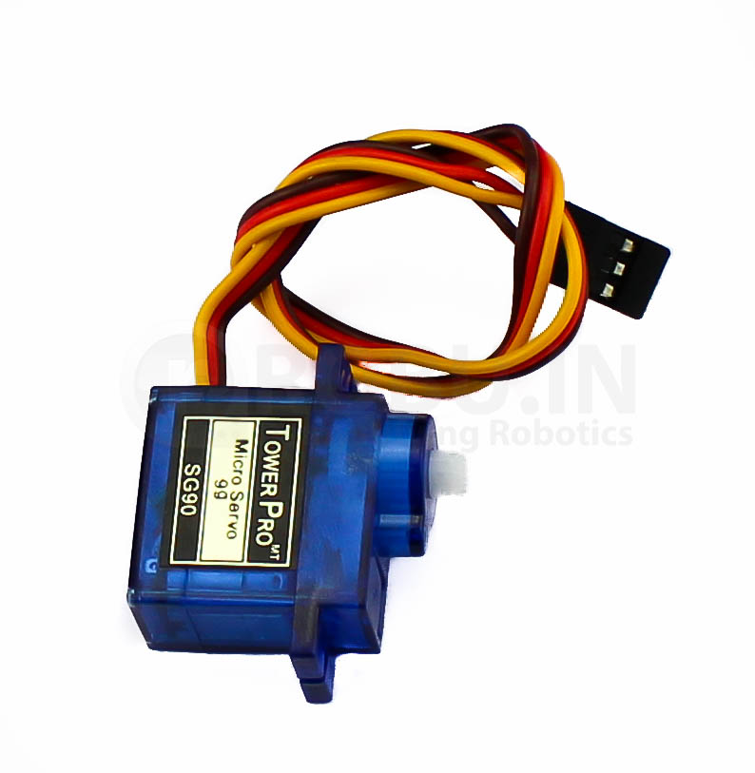
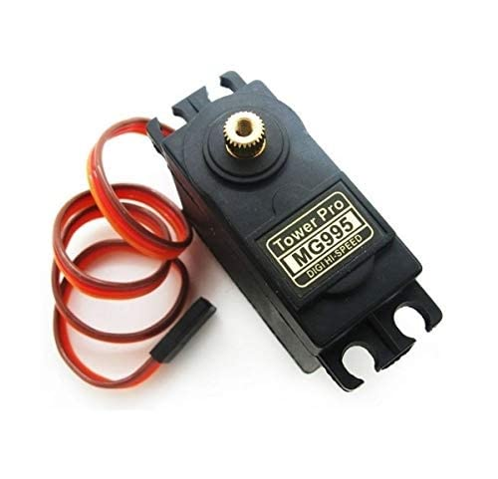
Servo
A servo is a Special motor which has a movement of 180 degrees and can be controlled by an Arduino to perform precise movements.
Servos for project :
1. SG90
2. MG995 (Metal Gear)

Slide 21
Software
3

Slide 22
Object detection and color detection
Wrote a script to identify the object placed infront of the camera
1. Used Python’s OpenCV module to get camera feed into the python readable format.
2. Used advanced AI to recognize the presence of the object and then detect its color.
3. Compute the data recived from the AI and process it to decide operations in to send it to the Arduino .

Slide 23

Arduino Code
The arduino will perform the operations based on the information passed on from the Python application.
Arduino uses C++ to write binary for it. Hence a Serial communication was required to be set up between the python and the C++ .
The code converts the data into mechanical operations and send the data through the data line and specifiy the movements for the arm.
Python Serial Port Programming was used to make this project feasible .

Slide 24
Thank You

